Slide 1
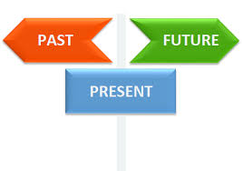
PAST SIMPLE TENSE AND PAST CONTINUOUS TENSE Mgr. Mária Tkáčová, PhD.
ZŠ Soľ 53
22. 12. 2021

Slide 2
Past simple TENSE
(minulý jednoduchý čas)
USE:
Jednoduchý minulý čas používame na vyjadrenie deja a stavu, ktorý sa udial v minulosti a je UKONČENÝ.
SIGNAL WORDS:
YESTERDAY (včera)
AGO (pred)
LAST (minulý)
AT (+ časový údaj)
ON (+ deň týždňa)
IN (+ mesiac/rok)

Slide 3
FORM:
Osoba (I/He/She/My brother/They/It) + sloveso v minulom čase (lived/played/did/had/) + zvyšná časť vety
I visited the Museum on Saturday.
He passed my driving test on 3 May
She broke his arm in June.
It saw that film two weeks ago.
We moved to Australia last year.
You arrived here at 9 o´clock.
They finished homework at 10 o´clock last night.

Slide 4
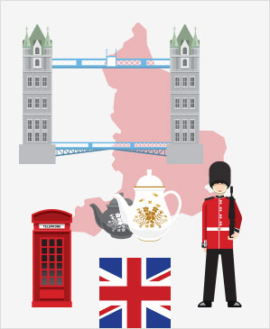
Negative:
I
He
She DID NOT see a shooting star.
It DIDN´T like the film two.
We answer the phone.
You
They

Slide 5
question:
DID + osoba (I/He/She/My brother/They/It) + sloveso v ZÁKLADNOM ČASE (live/play/do/have) + zvyšná časť vety
I
He go to Wimbledon?
DID She win the award?
It
We eat the strawberries?
You have a good time?
They
WHERE did you stay?
What mark did you get?
WHen did you go to England?
Why did you come home?
How did it go?

Slide 6
Short answers:
Did you enjoy your holiday?
Yes, I did.
No, I didn´t.
Did she win the award?
Yes, she did.
No, she didn´t.

Slide 7
Past continuous tense
USE:
Priebehový minulý čas používame, keď hovoríme, že niekto bol v strede deja alebo situácie v istom čase v minulosti

Slide 8
FORM:
I cooking dinner at 7 o´clock.
He WAS walking along the path.
She living in France in 2004.
It
We watching TV yesterday.
You WERE writing an e-mail yesterday?
They

Slide 9
Negative:
I
He
She was NOT watching TV.
It wasN´T cooking dinner.
We were NOT living in France in 2004
You weren´t eating dinner.
They

Slide 10
question:
I
He watching TV at 8 o´clock ?
was She eating a dinner?
It
WERE We eating the strawberries?
You
They
WHAT was he doing in the mountains ?
What were they trying to do?

Slide 11
Short answers:
Was she using your laptop last night?
Yes, she was.
No, she wasn´t.
Were they playing a game?
Yes, they were.
No, they weren´t.

Slide 12
Past simple AND Past continuous TENSE
USE:
Minulý jednoduchý a priebehový čas používame spolu, keď sa ukončená činnosť (Past Simple Tense) vyskytne uprostred neukončenej činnosti (Past Continuous Tense)
The phone rang when he was having a bath.
I was eating a sandwich when the door bell rang.
He was waiting for a bus when he saw his friend.
I burnt my hand when I was cooking lunch.
I was walking home when I met John.

Slide 13
EXERCISE
Choose the correct answer:
1. Mary prepared / was preparing lunch when they came / was coming.
2. Who was that nice girl you talked / were talking to when I walked / was walking by the pub?
3. Last weekend Susan fell / was falling and broke/ was breaking her leg.
4. When I entered / was entering the cafeteria Mary had / was having lunch with Peter.
5. The sun shone / was shining brightly when I got up / was getting up this morning.

Slide 14
THANK YOU FOR YOUR ATTENTION!

